Slide 1
Storage Virtualization & Data Access

Slide 2
Learning Outcomes
LO 4 : Evaluate: Evaluate resource management strategies, including scheduling algorithms and migration techniques, to optimize performance and security in multi-tenant environments LO 3 : Analyze system requirements to identify actors, processes, data, and interactions
LO 4 : Apply UML-based design artifacts to communicate a complete system solution

Slide 3
Outline
Block, File, and Object Storage
Virtual Disk Formats: QCOW2 and VHD
Storage Abstraction and Thin/Thick Provisioning

Slide 4
Block, File, and Object storage

Slide 5
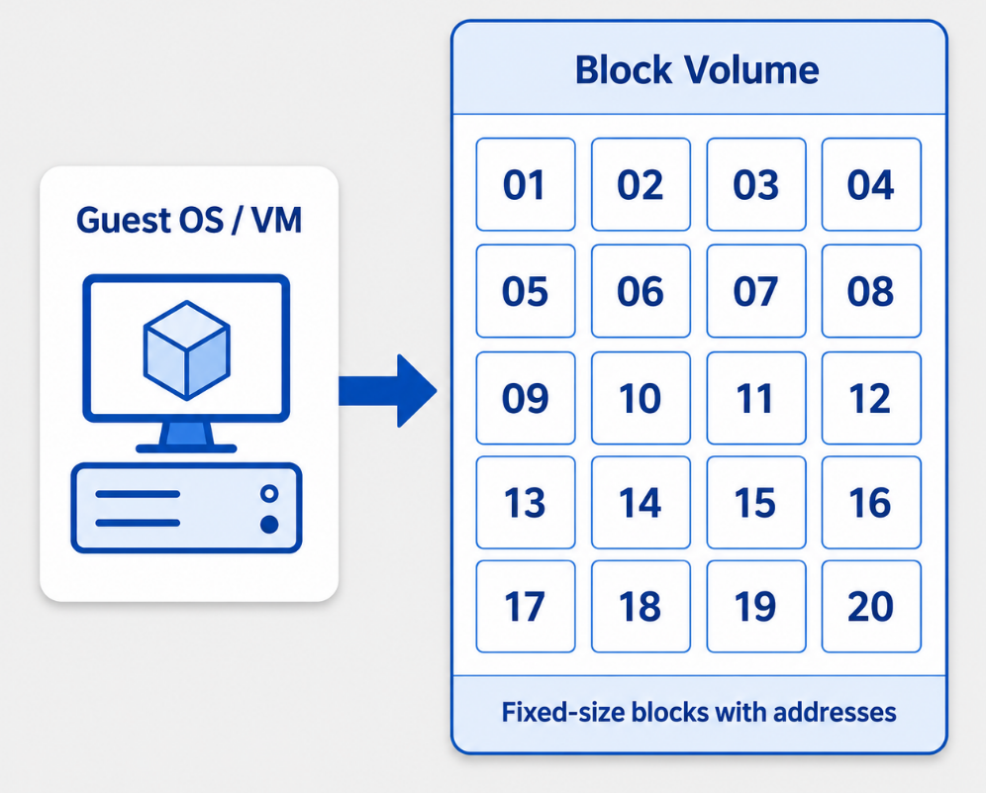
Block, File, and Object storage
Block Storage
Data is divided into fixed-size blocks
Each block has its own address
Used like a raw disk by the operating system
Common for VM disks and databases
High performance for low-level read/write access
Notes:
Block storage presents storage as a set of raw blocks. The operating system or application decides how to format and use those blocks. This model is commonly used for virtual machine disks and database workloads because it provides direct and efficient read/write access.

Slide 6
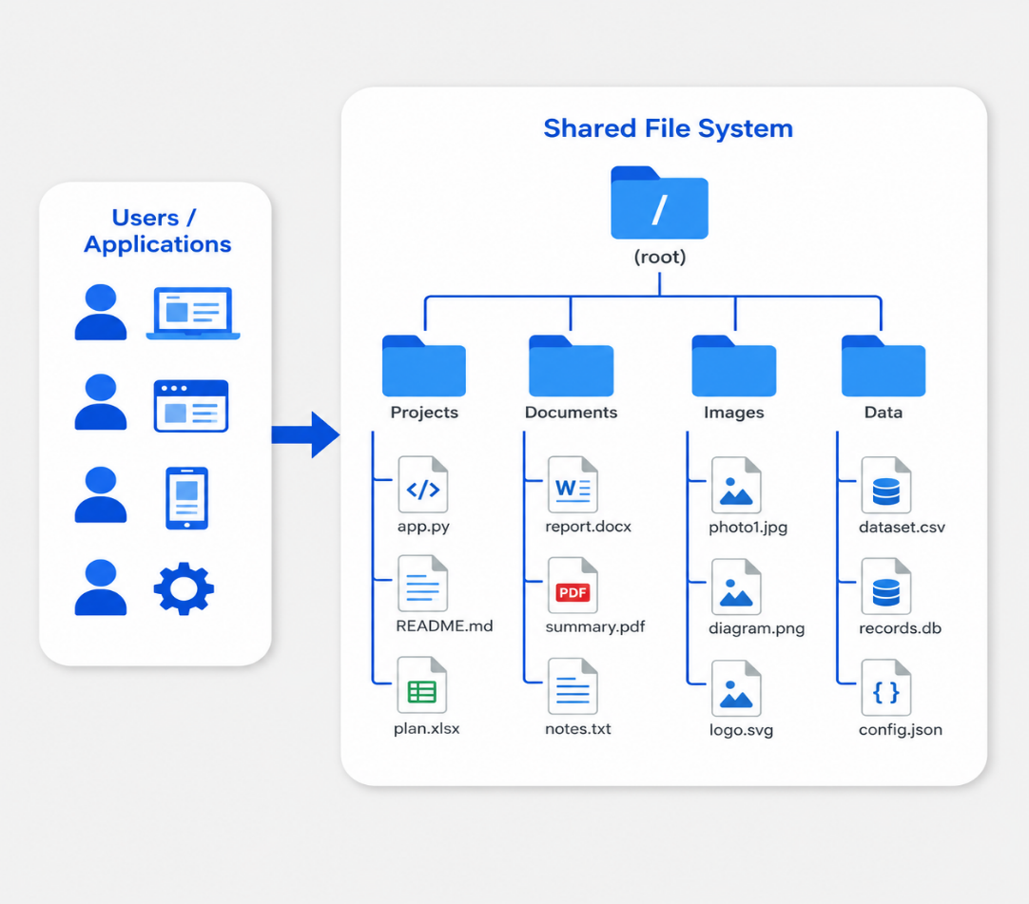
Block, File, and Object storage
File Storage
Data is organized as files and folders
Accessed through a shared file system
Supports human-readable hierarchy
Common for shared documents and app files
Multiple clients can access the same structure
Notes:
File storage organizes data in a familiar folder and file hierarchy. This makes it easy for users and applications to share files through a common file system. In cloud environments, file storage is often used when multiple systems need access to the same directory structure.

Slide 7
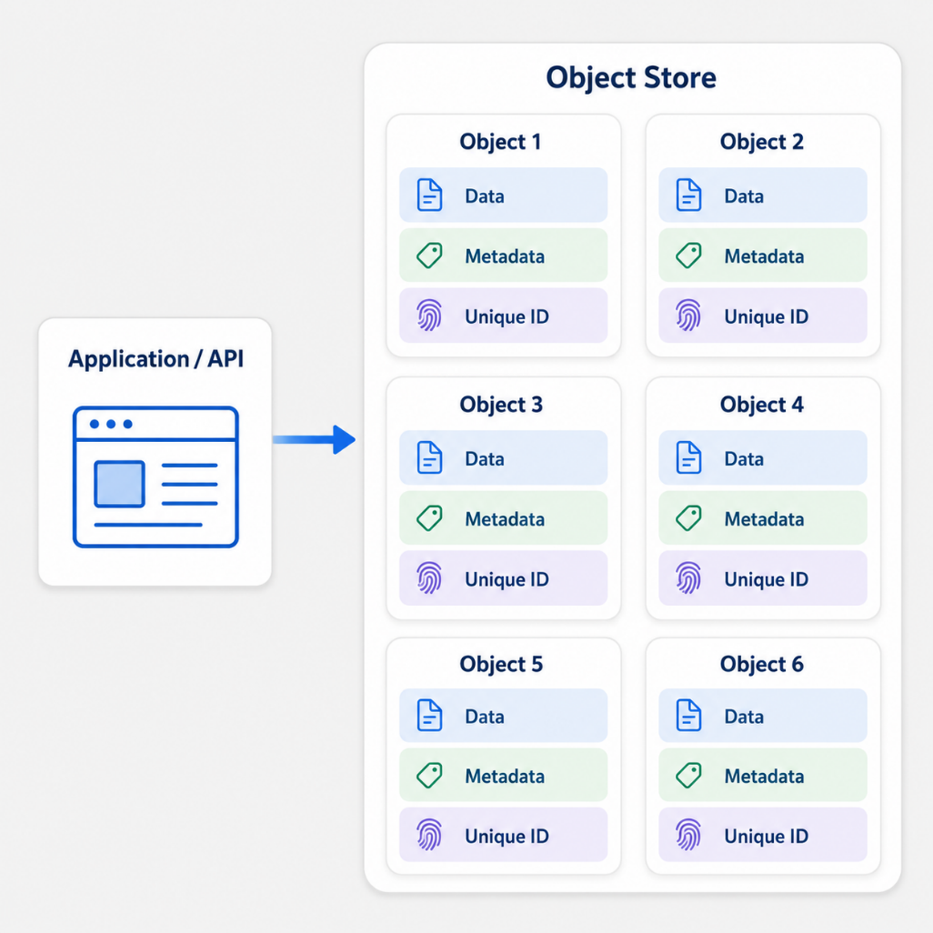
Block, File, and Object storage
Object Storage
Data is stored as objects
Each object includes data, metadata, and unique ID
Stored inside buckets or containers
Designed for massive scale
Common for backups, media, logs, and data lakes
Notes:
Object storage stores data as independent objects rather than blocks or folders. Each object includes the actual data, metadata, and a unique identifier. This makes object storage highly scalable and suitable for cloud-native workloads such as backups, media assets, log archives, and data lakes.

Slide 8
Block, File, and Object storage
Comparison
Block Storage | File Storage | Object Storage
Stores data in fixed-size blocks | Organizes data as files and folders | Stores data as objects
Accessed as a raw disk or volume | Accessed through a shared file system | Accessed through APIs
Common for VM disks and databases | Common for shared documents and app files | Common for backups, media, logs, and data lakes
Provides high performance and low-level control | Easy to understand and manage | Highly scalable for cloud environments
Requires OS or file system management | Can be harder to scale at very large size | Not ideal for frequent small updates
Notes:
This slide compares the three storage models side by side. Block storage works at a low level and is commonly used for virtual machine disks and databases. File storage uses a familiar folder hierarchy and is useful for shared access. Object storage is designed for large-scale cloud environments, where data is stored as objects and accessed through APIs.

Slide 9
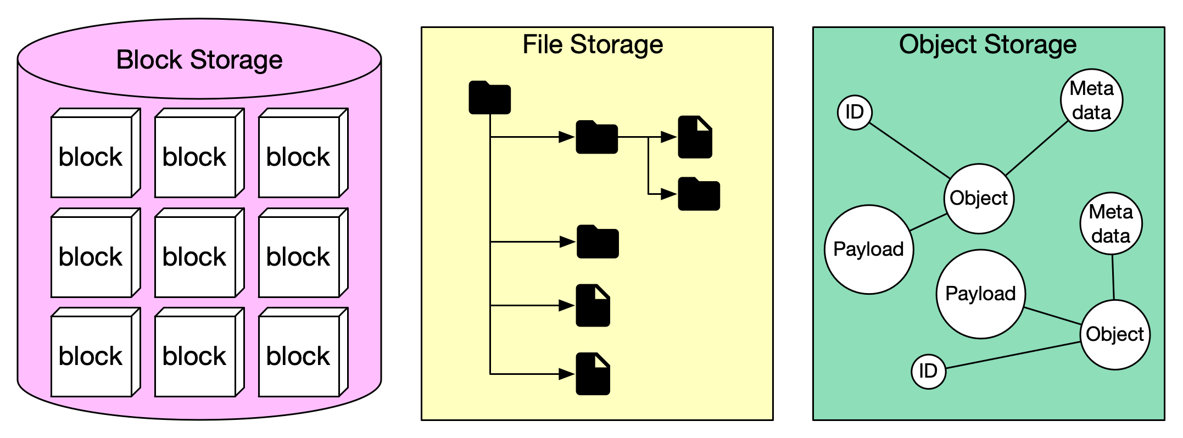
Block, File, and Object storage
Comparison
Image retreived from https://www.cherryservers.com/blog/what-is-block-storage
Notes:
Each storage model solves a different problem. Block storage is close to a raw disk and is useful for performance-sensitive workloads. File storage is easier to understand because it uses folders and files. Object storage is designed for large-scale cloud storage, especially when data is accessed through APIs rather than mounted as a traditional disk.

Slide 10
Virtual Disk formats (QCOW2, VHD)

Slide 11
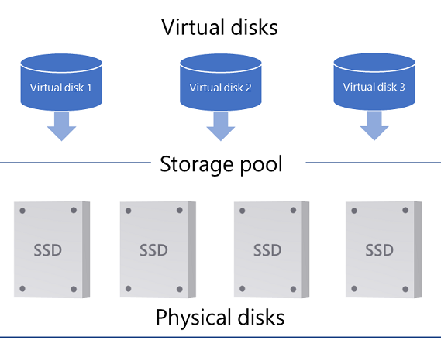
Virtual Disk formats (QCOW2, VHD)
Virtual Disk Definition
A disk presented to a virtual machine
Stored as a file on physical storage
The guest OS treats it like a real disk
Managed by the hypervisor or virtualization platform
Used to store OS, applications, and data
Image retreived from https://learn.microsoft.com/id-id/windows-server/storage/storage-spaces/storage-spaces-states
Notes:
A virtual disk is a disk abstraction used by a virtual machine. From the guest operating system perspective, it behaves like a physical hard drive. However, on the host side, it is usually stored as a disk image file that the hypervisor manages.

Slide 12
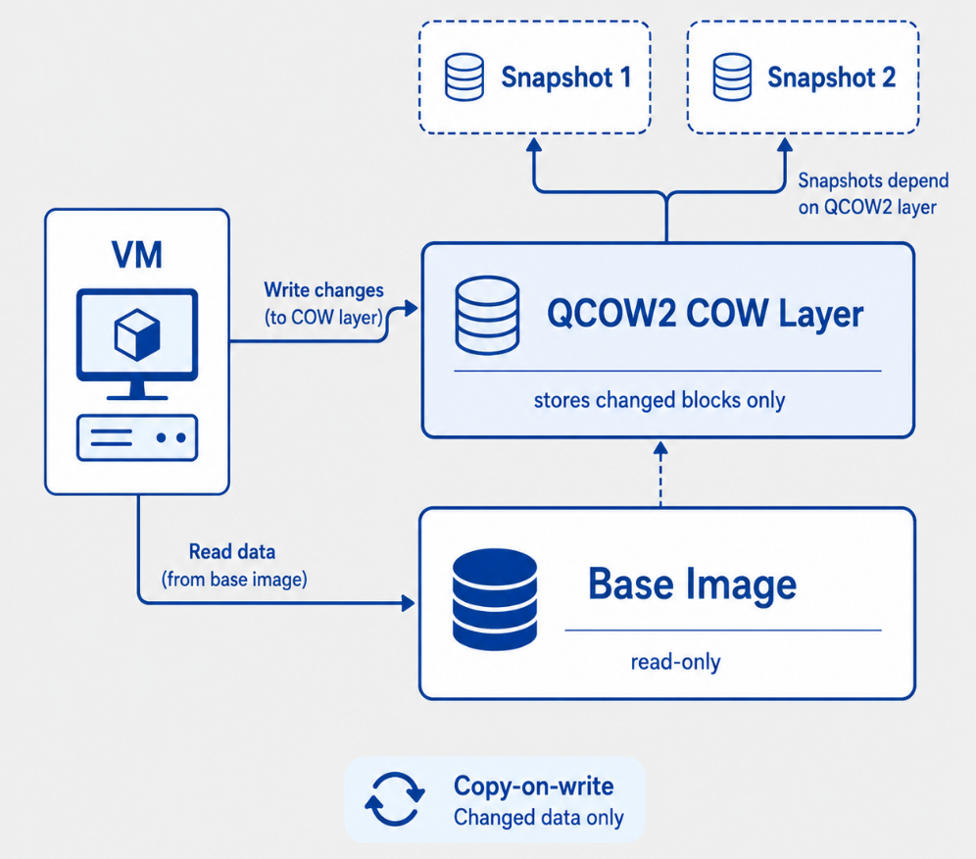
Virtual Disk formats (QCOW2, VHD)
QCOW2
QEMU Copy-On-Write disk format
Commonly used with QEMU/KVM
Supports snapshots and backing files
Stores only changed data when using COW
Useful for testing, templates, and VM cloning
Notes:
VHD stands for Virtual Hard Disk. It encapsulates a virtual hard drive into a file, allowing the virtual machine to use it as if it were a physical disk. It is strongly associated with Microsoft virtualization environments such as Hyper-V.

Slide 13
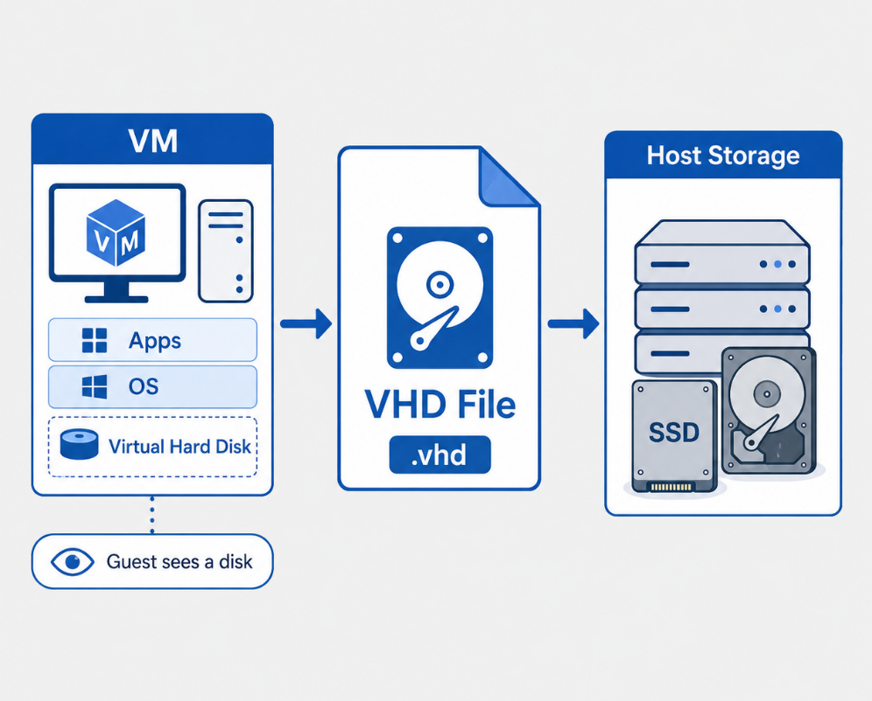
Virtual Disk formats (QCOW2, VHD)
VHD
Virtual Hard Disk format
Common in Microsoft virtualization
VM sees it as a physical disk
Stored as a disk image file
Used in Hyper-V and Windows environments
Notes:
A virtual disk is a disk abstraction used by a virtual machine. From the guest operating system perspective, it behaves like a physical hard drive. However, on the host side, it is usually stored as a disk image file that the hypervisor manages.

Slide 14
Virtual Disk formats (QCOW2, VHD)
QCOW2 vs. VHD Comparison
QCOW2 | VHD
QEMU/KVM-oriented format | Microsoft-oriented format
Supports copy-on-write | Represents a virtual hard disk file
Common for snapshots and templates | Common for Hyper-V environments
Efficient for changed-data layers | Simple disk image abstraction
Useful in Linux virtualization labs | Useful in Windows virtualization labs
Notes:
Both QCOW2 and VHD represent virtual disks, but they are common in different virtualization ecosystems. QCOW2 is strongly associated with QEMU and KVM, especially when snapshots and copy-on-write workflows are needed. VHD is more common in Microsoft virtualization environments and represents a virtual hard disk stored as a file.

Slide 15
Storage abstraction and thin/thick provisioning

Slide 16
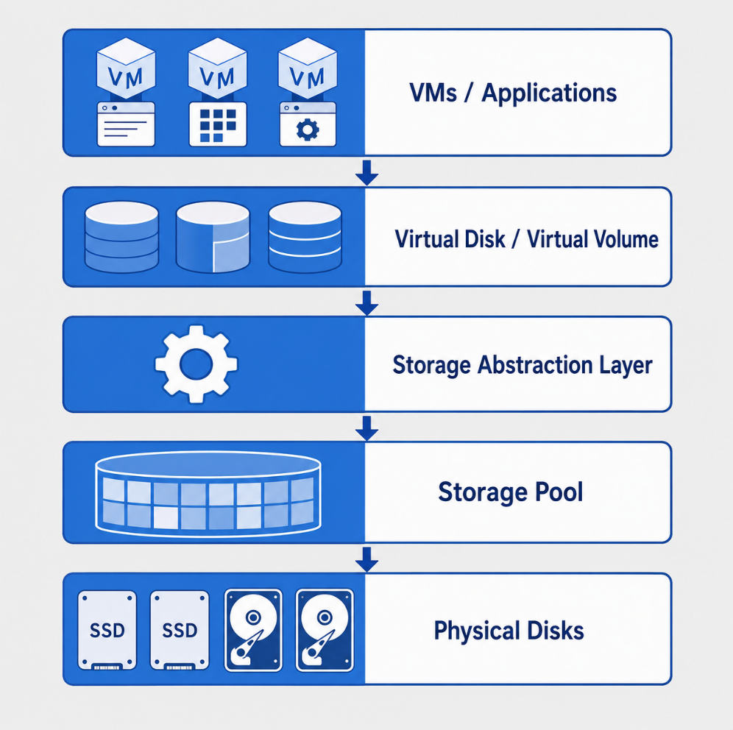
Storage abstraction and thin/thick provisioning
Storage Abstraction
Hides physical storage details from VMs
Combines disks into logical storage pools
Presents virtual disks or volumes to workloads
Enables flexible allocation and management
Supports scalable cloud infrastructure
Notes:
Storage abstraction separates what the virtual machine sees from the actual physical storage underneath. Instead of directly managing individual disks, the infrastructure presents logical volumes or virtual disks. This makes storage easier to allocate, move, resize, and manage in cloud environments.

Slide 17
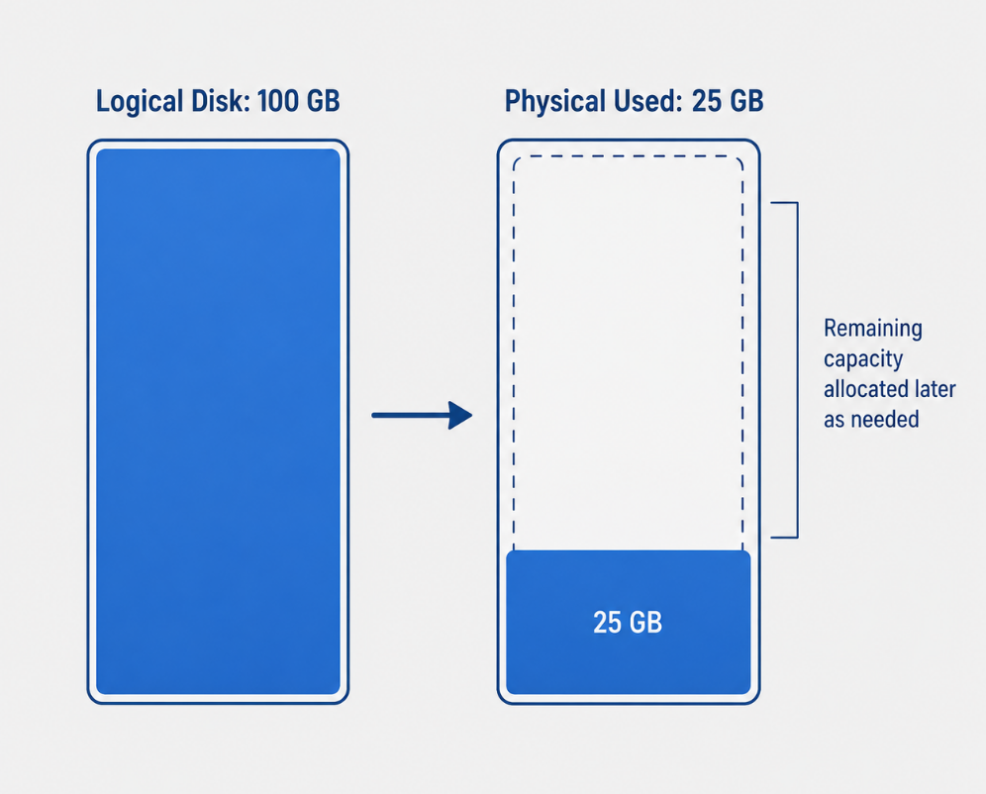
Storage abstraction and thin/thick provisioning
Thin Provisioning
Allocates storage on demand
VM sees a larger logical disk
Physical space is used only when data is written
Improves storage efficiency
Requires monitoring to avoid overcommitment
Notes:
Thin provisioning allows a virtual disk to appear larger than the physical space currently consumed. Storage is allocated gradually as data is written. This improves efficiency, but it also requires careful monitoring because too many thin-provisioned disks can overcommit the available storage pool.

Slide 18
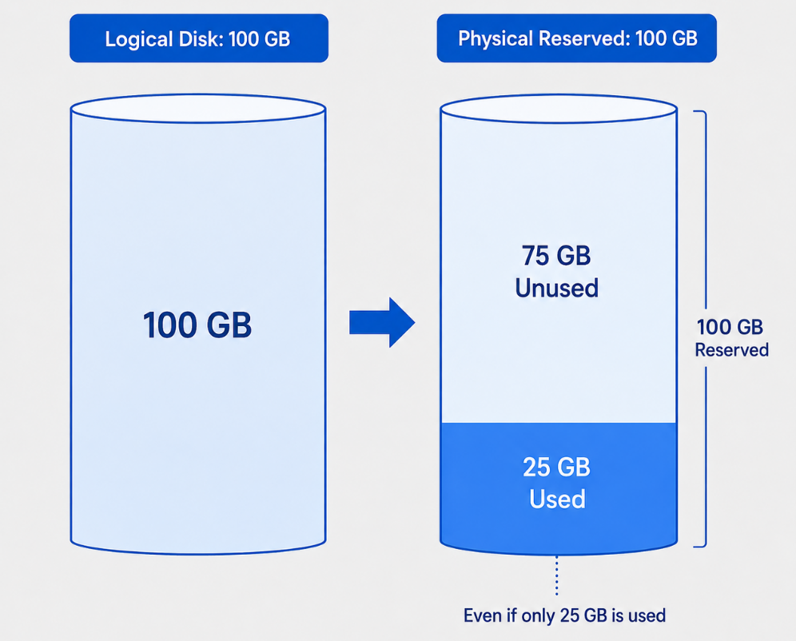
Storage abstraction and thin/thick provisioning
Thick Provisioning
Allocates full storage capacity upfront
Physical space is reserved immediately
More predictable capacity usage
Reduces risk of storage overcommitment
May waste unused storage space
Notes:
Thick provisioning reserves the full capacity of a virtual disk at creation time. Even if the VM only uses a small amount of data, the full space is already allocated on the physical storage. This is more predictable, but less space-efficient compared with thin provisioning.

Slide 19
Virtual Disk formats (QCOW2, VHD)
QCOW2 vs. VHD Comparison
Thin Provisioning | Thick Provisioning
Allocates storage on demand | Allocates full space upfront
Efficient use of physical storage | Predictable storage reservation
VM may see more space than currently used | VM space is fully reserved
Risk of overcommitment | Lower overcommitment risk
Best for flexible cloud environments | Best for predictable workloads
Notes:
Thin and thick provisioning represent two different trade-offs. Thin provisioning prioritizes efficiency and flexibility, while thick provisioning prioritizes predictability and reserved capacity. Cloud environments often use thin provisioning, but administrators must monitor physical capacity carefully.

Slide 20
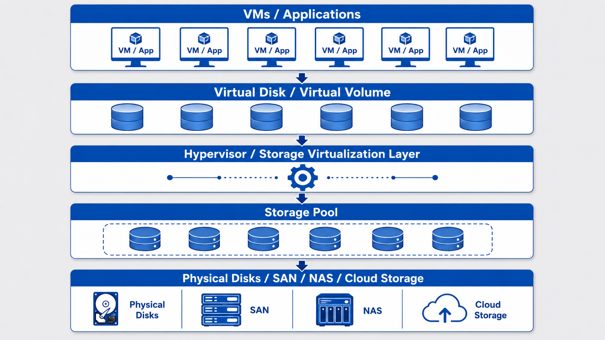
Virtual Disk formats (QCOW2, VHD)
Storage Virtualization Architecture
Notes:
Thin and thick provisioning represent two different trade-offs. Thin provisioning prioritizes efficiency and flexibility, while thick provisioning prioritizes predictability and reserved capacity. Cloud environments often use thin provisioning, but administrators must monitor physical capacity carefully.

Slide 21
Exercises
Architectural Use Cases
Different applications require different storage architectures depending on their data access patterns.
Question: If you are deploying an enterprise relational database (like PostgreSQL) that requires microsecond latencies for random read/write operations, why would you choose Block Storage over File or Object Storage?

Slide 22
Reference
Amazon Web Services. (n.d.). What’s the difference between block, file, and object storage? Retrieved June 21, 2026, from https://aws.amazon.com/compare/the-difference-between-block-file-object-storage/
Erl, T., & Barceló Monroy, E. (2024). Cloud computing: Concepts, technology, security & architecture (2nd ed.). Pearson.
GeeksforGeeks. (2025, July 23). What is storage virtualization? Retrieved June 21, 2026, from https://www.geeksforgeeks.org/cloud-computing/what-is-storage-virtualization/
Katzer, J. (2020). Learning serverless: Design, develop, and deploy with confidence. O’Reilly Media.
Marinescu, D. C. (2022). Cloud computing: Theory and practice (3rd ed.). Elsevier.
Notes:
Thin and thick provisioning represent two different trade-offs. Thin provisioning prioritizes efficiency and flexibility, while thick provisioning prioritizes predictability and reserved capacity. Cloud environments often use thin provisioning, but administrators must monitor physical capacity carefully.

